Slide 1
Italy Road Accident Risk Analysis Capstone Project – Boolean Master in Data Analytics
Business Problem: A risk-prevention company needs to identify the best Italian towns for road traffic investment, moving away from unreliable raw data.
Objective: Analyze historical data (2001–2024) to classify accident risk not just by frequency, but by severity.
Scope: ~7,500 "stable" Italian towns, assessing where accidents happen most and where they are most fatal.
Problem
Extract and Clean data
EDA and Clustering
Power Bi Dashboard
Key Findings

Slide 2
Data Pipeline and Preprocessing
Data Sources: ISTAT SDMX API (accidents, injuries, deaths) + SITUAS API (population, surface area).
Automated Extraction: Python requests notebook cell fetching 24 yearly CSVs dynamically.
Data Cleaning:
Filtered to "stable" towns (present in all 24 years) to avoid merger/split bias.
Pivoted long-to-wide format for a clean merge.
Normalized the metric columns to 1,000 people to rescale the values.
Edge Cases: Distinguished '0 incidents' (NaN) from '0% fatality' (0) in Fatality Rate column calculation to prevent statistical distortion.
Tools: Python (Pandas, Requests, Numpy) ,VS code, GIT
Problem
Extract and Clean data
EDA and Clustering
Power Bi Dashboard
Key Findings

Slide 3
EDA and Risk Clustering
Tools: Python (scikit-learn, seaborn/matplotlib),VS code, GIT
EDA (Exploratory Data Analysis):
Highly right-skewed distributions (Italy = many small towns, few large cities).
Applied Log scale to correctly view data distributions and compared Pearson vs. Spearman correlations.
Clustering (K-Means, k=3):
Features: Accident, Injury, Death, and Fatality Rates.
Preprocessing: Log transformation (reduce variables skewness) + Standardization (rescale values to similar ranges). Used Elbow Method to calculate the optimal number of clusters.
Key Insight: The "High Risk" cluster is defined by severity (high fatality rate), not by accident volume.
Problem
Extract and Clean data
EDA and Clustering
Power Bi Dashboard
Key Findings

Slide 4
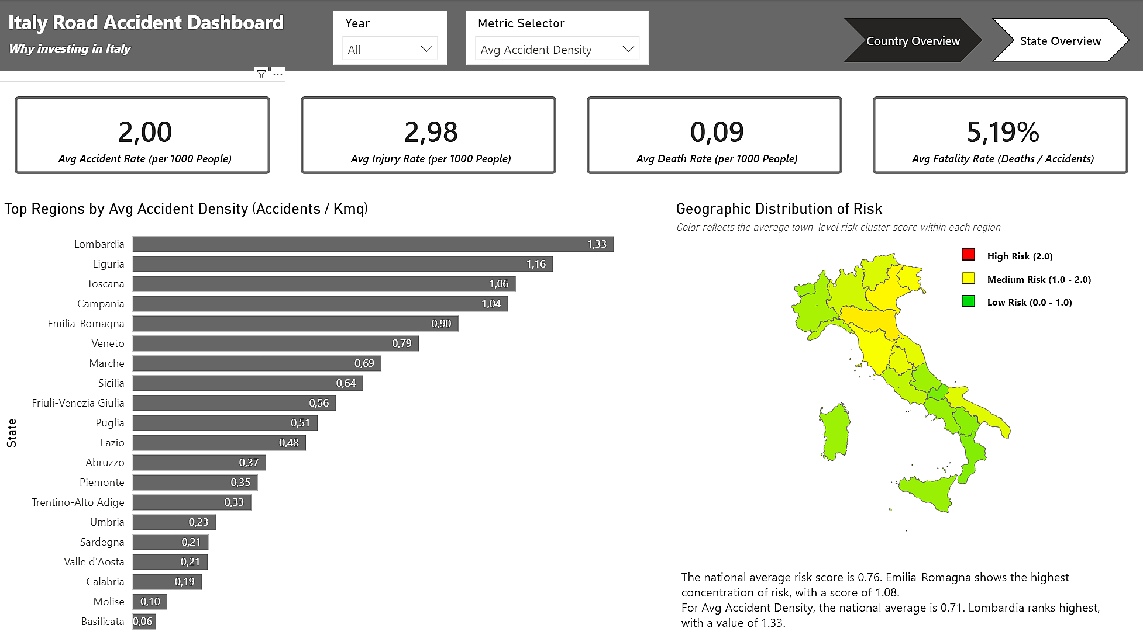
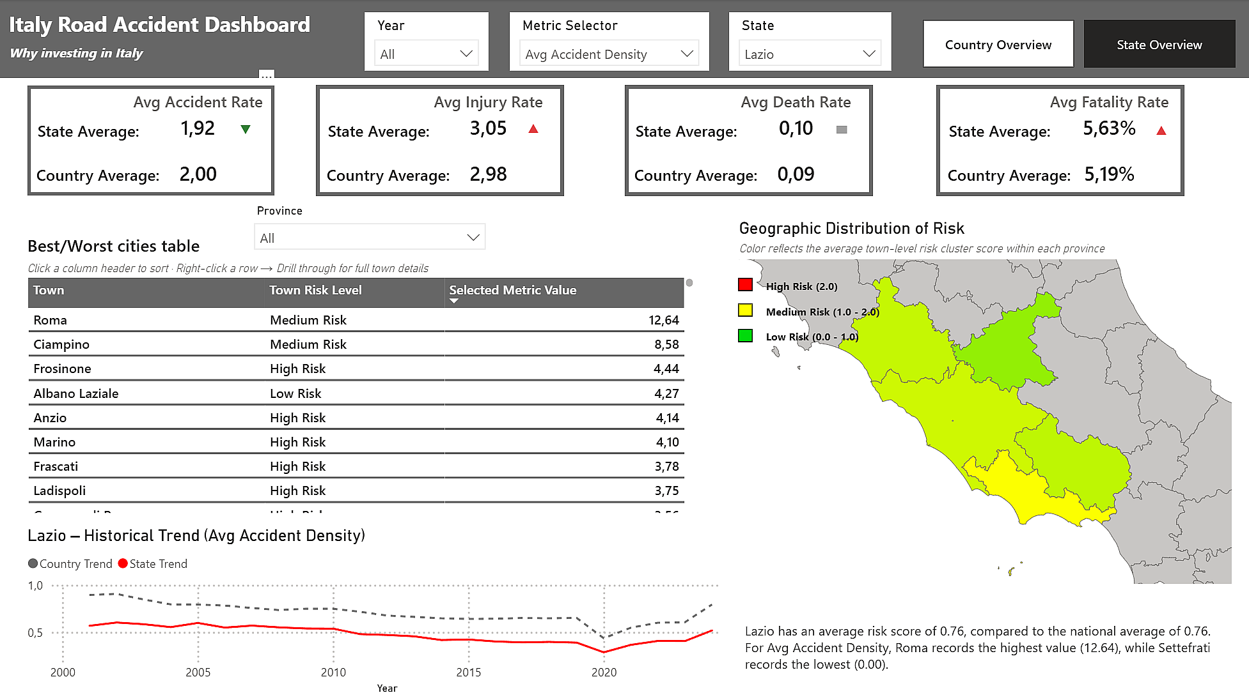
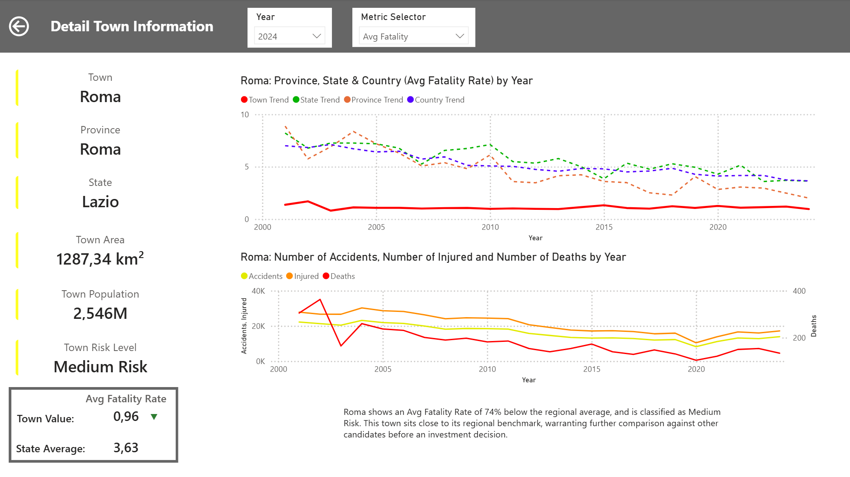
Interactive Power BI Dashboard
Structure: 3 pages (Country Overview → State Overview → Town Detail).
Dynamic Features: Field Parameters for on-the-fly metric switching, Shape Maps with risk gradients, Drillthrough navigation, Year slicer and Page navigator.
Storytelling: DAX-generated dynamic narratives summarizing insights and providing an "Investment Verdict" for each town in Town detail page.
View screenshots in screenshots\ folder or dashoboard.pbix to further details
Tools: Power BI, DAX, GIT
Problem
Extract and Clean data
EDA and Clustering
Power Bi Dashboard
Key Findings

Slide 5
Key findings and Takeaways
Severity vs. Volume: Risk concentrates where severity is disproportionate, not where accident volume is highest (e.g., large cities).
North vs. South: Southern regions have lower overall accidents but higher average fatality rates, suggesting infrastructure or emergency response gaps.
Historical Trend: A clear decline in accidents since 2001 (likely due to policy/awareness), accelerated further in 2020–2021 due to the COVID-19 pandemic, which drastically reduced traffic on the roads.
Problem
Extract and Clean data
EDA and Clustering
Power Bi Dashboard
Key Findings

